Slide 1
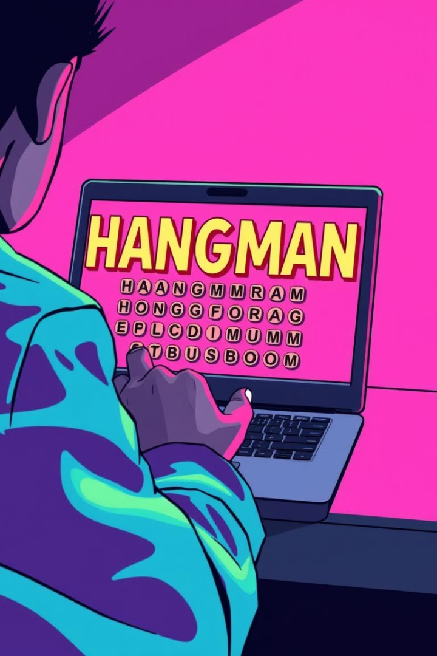

Hangman: A Classic Game Reimagined in Python and Tkinter
Welcome to this presentation where we'll explore a modern reimagining of the classic game Hangman, using the power of Python and the Tkinter library. We'll take a journey through the development process, from the initial concept to the final product.
by Praneeth Reddy

Slide 2
Introduction to the Hangman Game Concept
The Classic Concept
Modern Twist
Hangman is a word guessing game where players try to guess a hidden word letter by letter. Each incorrect guess adds a part of the hangman figure, leading to the game's namesake.
We'll be using Python and Tkinter to create a visually engaging and interactive version of this classic game. We'll add features to enhance the user experience and make the gameplay more enjoyable.

Slide 3
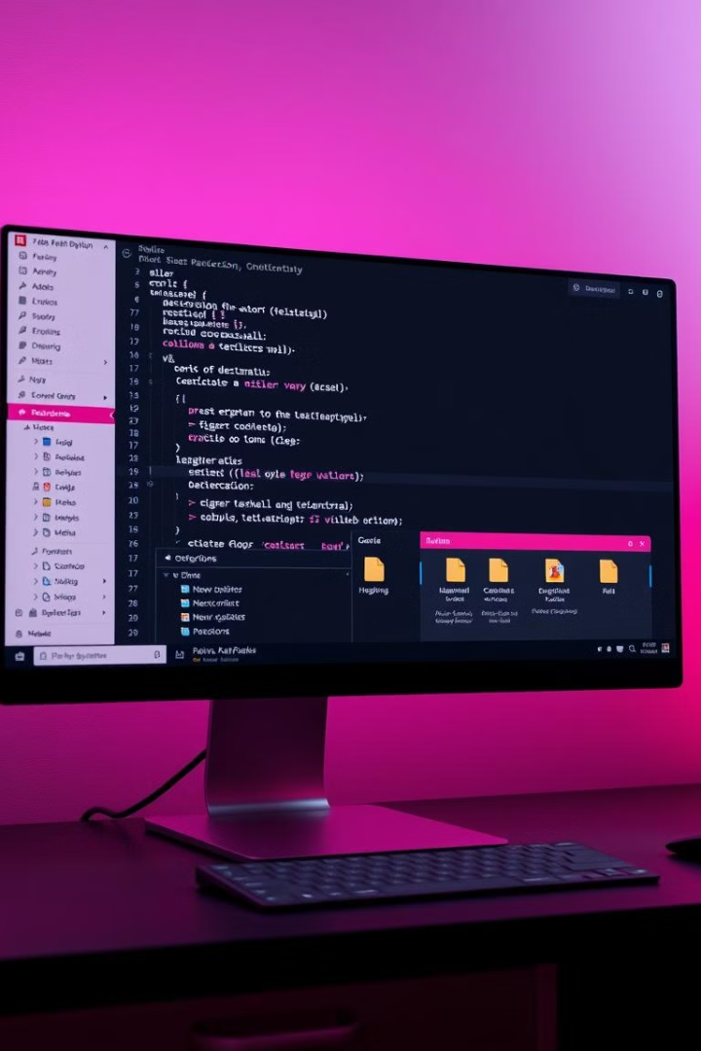
Setting up the Project: Python and Tkinter Environment
1
Python Installation
2
Tkinter Library
Tkinter is Python's standard GUI toolkit. It allows us to create interactive visual elements for our Hangman game.
Ensure Python is installed on your system. We'll be using Python's versatile programming capabilities for game logic and interactions.

Slide 4

Designing the Graphical User Interface (GUI)
Game Board
User Input
Visual Feedback
We'll design a visual representation of the game board, including the hangman figure, blank spaces for the letters, and an area to display the alphabet.
We'll create interactive elements for user input, such as clickable buttons for the alphabet, a space for the user to enter guesses, and a button to start a new game.
Visual elements like a score counter and a progress bar will provide feedback to the player, giving them a clear understanding of their game status.

Slide 5
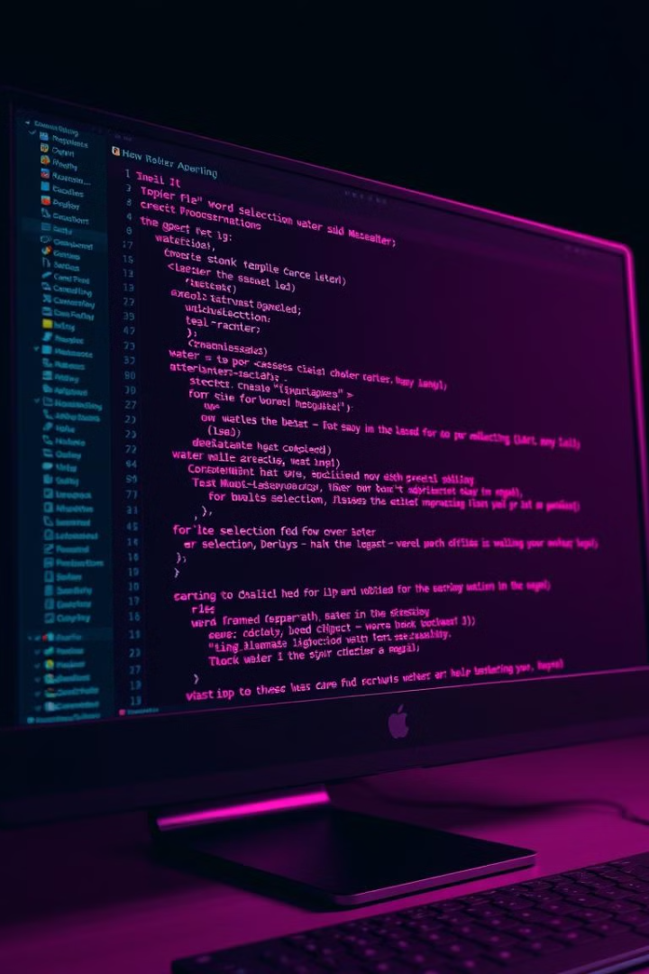


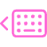
Implementing the Word Selection Mechanism
Word List
We'll create a list of words or a method to retrieve words from a file, ensuring a variety of difficulty levels.
Random Selection
Python's random module will be used to select a random word from the list or file, ensuring a fair and unpredictable game.
Word Hiding
The selected word will be hidden from the player, represented by a series of blank spaces. We'll use underscore characters to visually represent this.

Slide 6
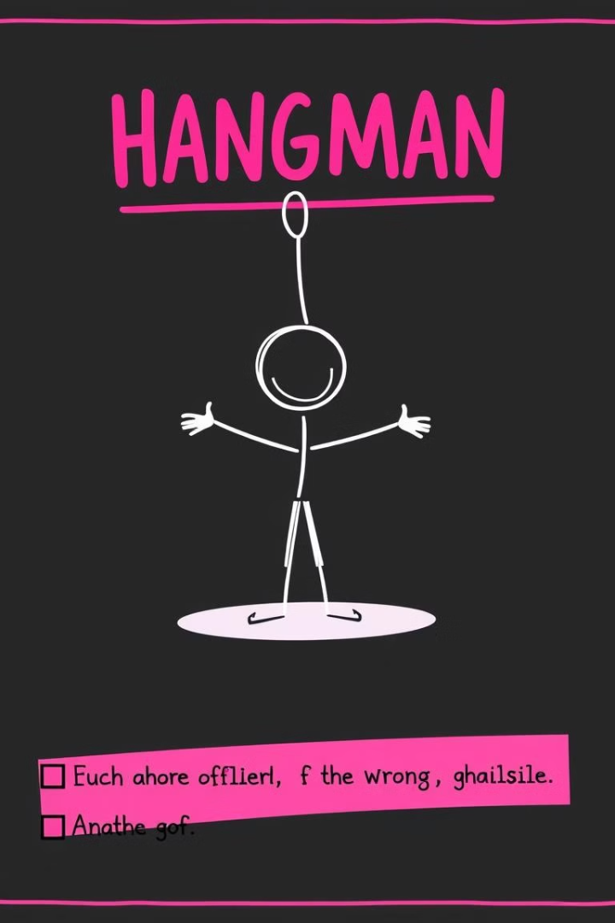
Tracking Guesses and Updating the Hangman Diagram
1
Initialize the Hangman Diagram: At the start of the game, the diagram is empty. The player starts with a blank canvas, awaiting guesses.
2
Each Incorrect Guess: As the player makes wrong guesses, the Hangman Diagram gradually takes shape, with each incorrect attempt adding a new body part to the figure.
3
Complete Hangman Figure: After a certain number of incorrect guesses, the Hangman Diagram will be complete, signaling a loss for the player.

Slide 7
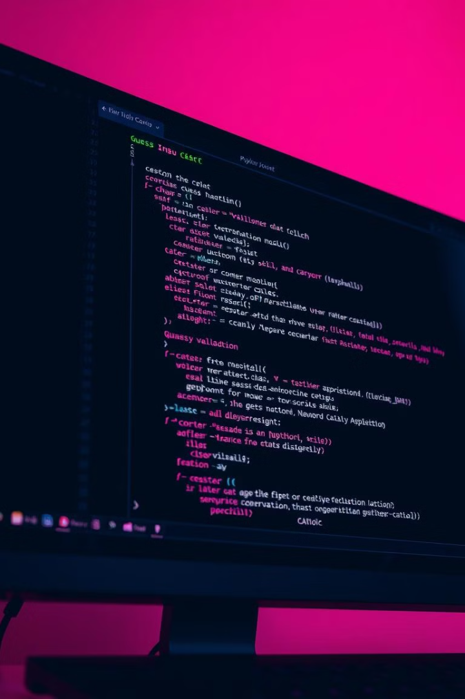

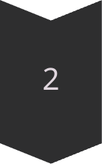

Handling User Input and Validating Guesses
Input Collection
We'll implement a mechanism for the user to enter guesses through buttons, text input, or a combination of both.
Guess Validation
The code will check if the entered guess is a valid letter, ensuring that the game only accepts valid characters.
Guess Tracking
A system for tracking already guessed letters will be implemented, preventing players from guessing the same letter multiple times.

Slide 8



Implementing the Game Logic and Win/Loss Conditions
Letter Matching
1
When the user guesses a letter, the code will check if it's present in the hidden word. If so, the letter is revealed on the game board.
Win Condition
2
The game ends with a win when the player correctly guesses all the letters in the hidden word. The player will receive a celebratory message.
Loss Condition
3
The game ends with a loss when the player makes a certain number of incorrect guesses, resulting in the full Hangman figure.

Slide 9
Enhancing the User Experience with Animations and Sounds
Animation
1
We'll add animated elements to the game, such as gradually drawing the Hangman figure, highlighting the correct guesses, and adding visual effects for wins and losses.
Feedback
2
Cues and visual feedback will provide immediate responses to user actions, making the game more engaging and intuitive for the player.

Slide 10
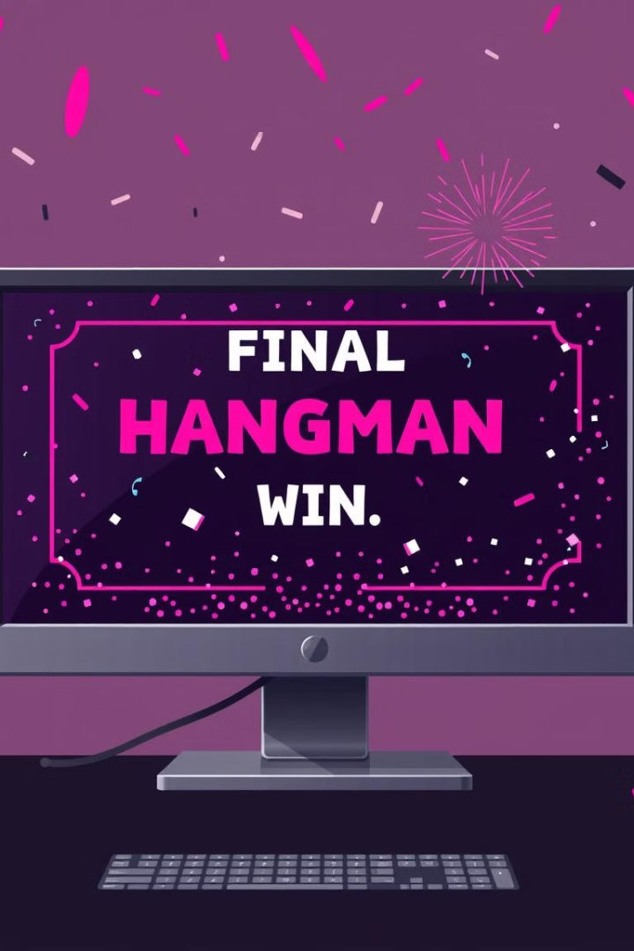
Conclusion: Reflections and Next Steps
1
2
Classic Appeal
Future Possibilities
This project showcased how a classic game like Hangman can be brought to life in a modern and engaging way using Python and Tkinter.
Future iterations could include new gameplay features, such as adding difficulty levels, themes, or even multiplayer capabilities.

